Slide 1
LIGHTNING TALK #2 – Ali Hussain Yousif
Adult Income Prediction
Predicting whether an individual earns more than $50K a year from census demographic and employment data
Binary Classification | UCI Adult Census Income Dataset
Data Science Bootcamp • Capstone Part 2

Slide 2
Problem Statement
Classification Problem
THE RAW ISSUE Workforce and career-development organizations often rely on broad strategies because they cannot identify which individuals are more likely to achieve higher income levels. This makes it difficult to provide targeted support and understand the factors associated with economic success.
THE STRUCTURED OBJECTIVE
We aim to classify individuals into "high income" (>50K/year) or "lower income" (≤50K/year) groups using demographic and employment characteristics such as education, occupation, age, working hours, and capital gains/losses. This model will help workforce analysts identify the key factors associated with higher income and support more targeted career-development strategies, achieving an F1-score ≥ 0.70 and ROC-AUC ≥ 0.85 for the high-income class.

Slide 3
Audience & Project Goals
Potential Audience Workforce Development & Career Analytics Teams
Move from broad programs to data-driven career insights based on income patterns.
Using income prediction insights to:
MACHINE LEARNING GOALS
Binary classification model: income >$50K vs ≤$50K.
Compare 4 models: Logistic Regression, Decision Tree, Random Forest, Gradient Boosting.
Evaluate with Accuracy, Precision, Recall, F1-score and ROC-AUC (class imbalance aware).
Select best model on F1 / ROC-AUC for the minority (>$50K) class.
Understand factors associated with higher income.
Support career-development strategies.
Identify important employment patterns.
Adult Income Prediction • Lightning Talk #2

Slide 4
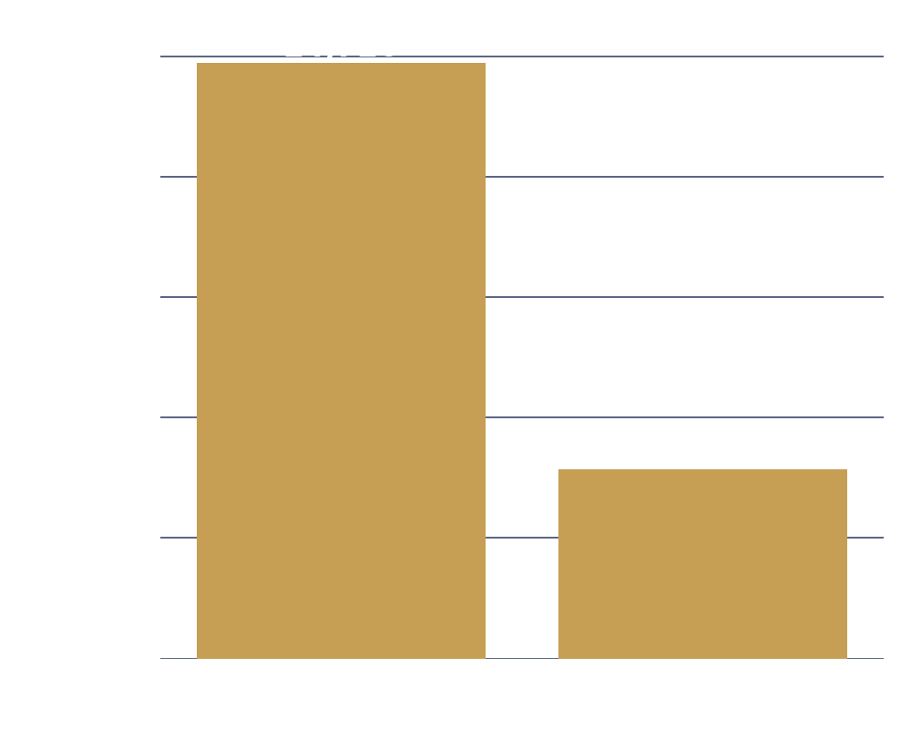
About the Data
UCI Adult / Census Income dataset
PROBLEM TYPE : Binary Classification
32,561
15
24.1%
3
Rows
Columns
Earn > $50K (target)
Columns with missing values
KEY FEATURES
age, hours.per.week — Numerical — demographic & work intensity
education — categorical education level education.num — numerical representation of education level
occupation, workclass — Job type & employment sector
marital.status, relationship, race, sex — Demographic / household context
capital.gain, capital.loss — Investment income indicators
income — Target: ≤$50K or >$50K
Income class split (target)
Adult Income Prediction • Lightning Talk #2

Slide 5
Data Cleaning Findings
Missing Values
Outliers
Class Imbalance
placeholders found in’?’:
workclass
occupation
native.country
Treatment:
Converted '?' to missing values and applied mode imputation for categorical columns.
Heavy-tailed features:
fnlwgt
capital.gain
capital.loss
Decision:
Retained because they represent valid variation rather than data errors.
Target is imbalanced: 75.9% earn ≤$50K vs 24.1% earn >$50K. Addressed by evaluating with F1-score and ROC-AUC rather than accuracy alone.
Duplicate Records:
24 duplicate rows identified. Removed duplicates before analysis.
Net takeaway: the data is clean enough to model after removing duplicate records and resolving missing values through imputation.
Adult Income Prediction • Lightning Talk #2

Slide 6
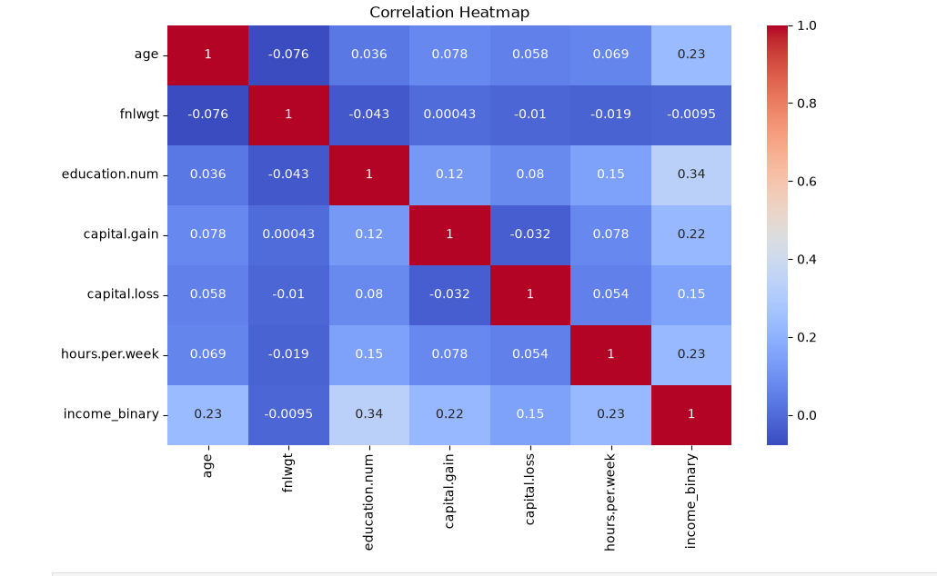
Numeric Features vs. Income
FINDINGS
Key Findings:
Education Number
Strongest positive linear association with income.
Correlation ≈ 0.34
Age
Moderate positive relationship.
Higher-income individuals are concentrated around 35–55 years.
Hours Worked
Higher-income group tends to work more hours.
Capital Gain
Higher values are associated with >50K income.
Adult Income Prediction • Lightning Talk #2

Slide 7
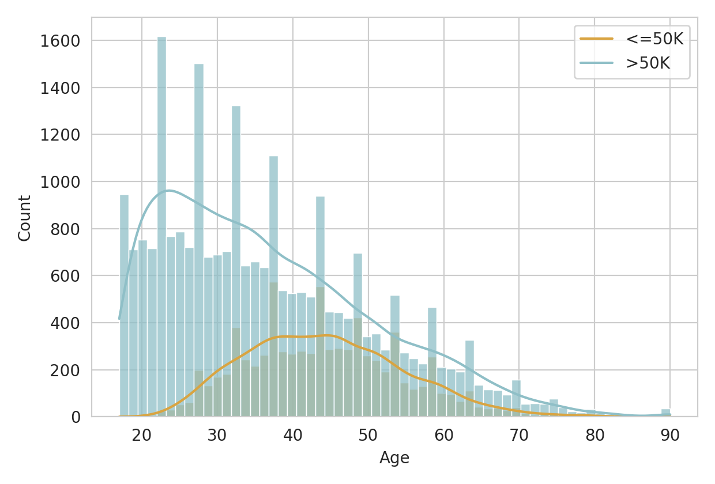
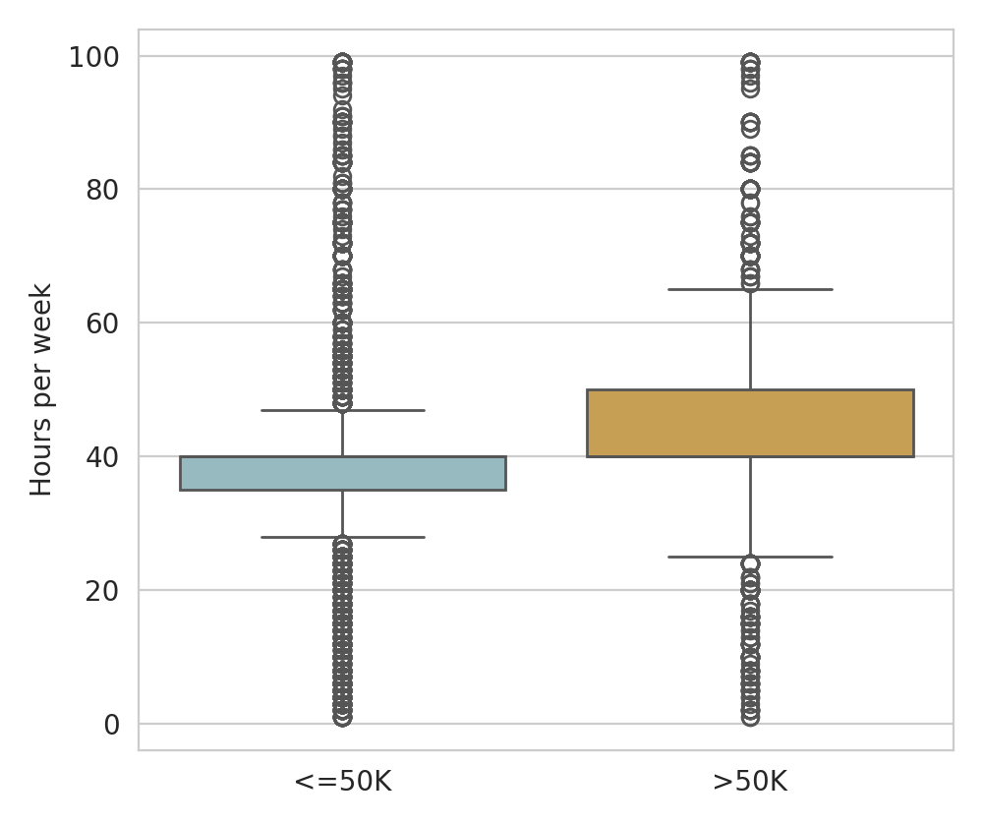
Age & Hours
Age: high-income earners skew toward the 35–55 range. Hours worked: the >$50K group works noticeably longer weeks on average.
Adult Income Prediction • Lightning Talk #2

Slide 8
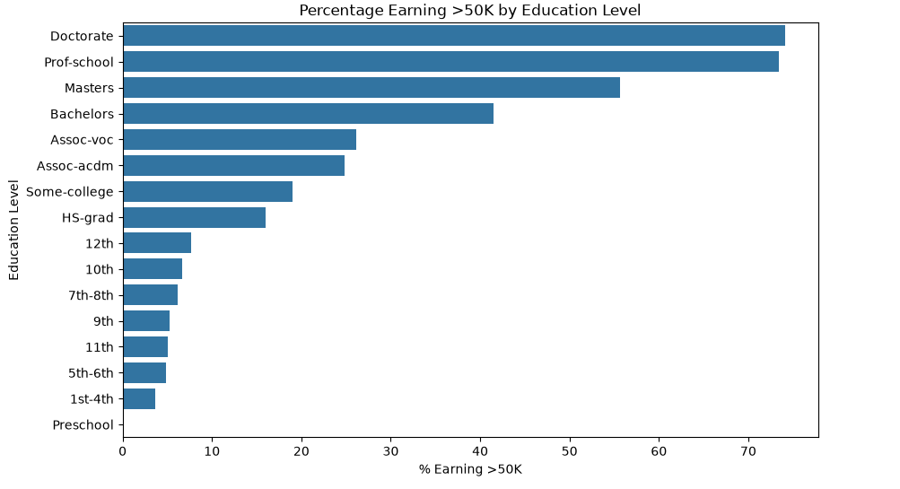
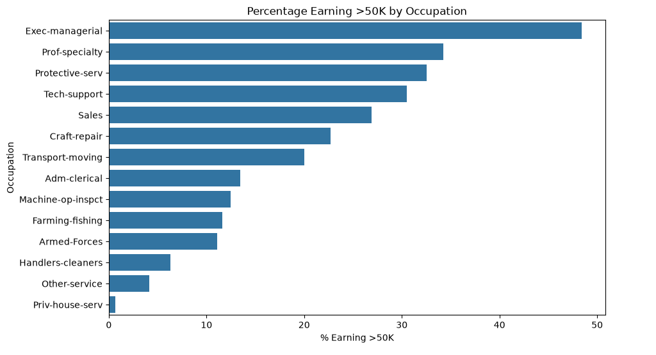
Categorical Features vs Income
Education
(Percentage earning >50K)
Advanced education levels such as Masters and Doctorate show higher proportions of >50K earners.
Occupation
Exec-managerial and Prof-specialty occupations have higher proportions of high-income individuals.
Chi-Square Test
Chi-square tests showed significant associations between categorical features and income class (p < 0.05). Chi-square tests confirmed significant associations between categorical features and income class.

Slide 9
Preprocessing & Modelling Plan
PREPROCESSING
MODEL CANDIDATES
EVALUATION
80/20 train-test split, stratified on income
StandardScaler on numerical features
To make numerical features comparable for scale-sensitive models
OneHotEncoder on categorical features(Convert categorical variables into numerical representations.)
Evaluate fnlwgt contribution and decide whether to retain or remove it.
Feature Evaluation
Evaluate fnlwgt contribution.
Review redundancy between:education ,education.num
Logistic Regression — interpretable baseline
Decision Tree — non-linear splits
Random Forest — reduces overfitting
Gradient Boosting — strong candidate for tabular classification
Accuracy, Precision, Recall
F1-score (primary, imbalance-aware)
ROC-AUC
Best model chosen on F1 / ROC-AUC
Adult Income Prediction • Lightning Talk #2

Slide 10
Model Strengths & Limitations
Model | Strength | Limitation
Logistic Regression | Fast, interpretable, solid baseline for a linear relationship | May underfit non-linear interactions between features
Decision Tree | Captures non-linear rules (e.g. education + hours thresholds) | Prone to overfitting; can memorize training data
Random Forest | Combines many trees; reduces overfitting & variance | Less interpretable; heavier to compute than a single tree
Gradient Boosting | Sequentially corrects errors; typically best raw performance | Needs careful tuning; slower to train, easier to overfit
Adult Income Prediction • Lightning Talk #2

Slide 11
Progress Report
DONE
NEXT STEPS
Data cleaning completed.
Missing values handled.
Duplicate records removed.
EDA completed.
Modeling plan defined.
Challenges
Class imbalance.
Sensitive demographic variables.
Dataset represents a specific population/time period.
Feature redundancy: education vs education.num
• Potential bias from demographic variables.
• Dataset may not generalize to different populations.
Build preprocessing pipeline.
Train 4 candidate models.
Apply cross-validation.
Tune hyperparameters.
Compare F1-score and ROC-AUC.
Select final model.
Adult Income Prediction • Lightning Talk #2

